Slide 1
Multiple Linear Regression
Some helpful links (Check in notes): https://www.youtube.com/watch?v=dQNpSa-bq4M&list=PLIeGtxpvyG-IqjoU8IiF0Yu1WtxNq_4z-
Notes:
Brandon Foltz: https://www.youtube.com/watch?v=dQNpSa-bq4M&list=PLIeGtxpvyG-IqjoU8IiF0Yu1WtxNq_4z-
PennState: https://newonlinecourses.science.psu.edu/stat501/node/250/

Slide 2
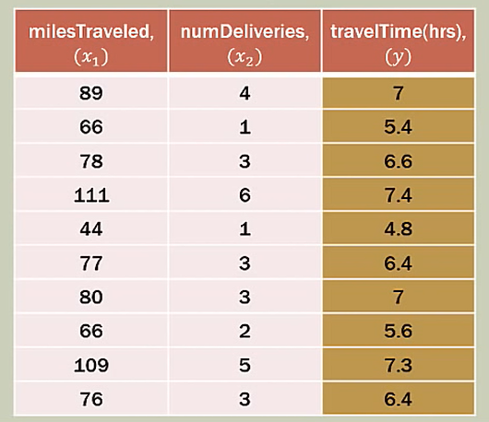
Problems to solve
How can we predict data with 2 independent (explanatory) variables?

Slide 3
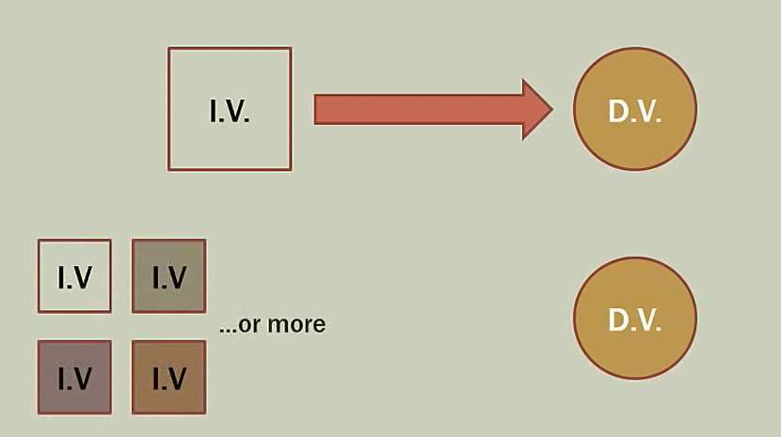
Concept
Problems may arise:
Overfitting
Multicollinearity

Slide 4
Step
Data preparation
Find gradient constants for each linear
Create Equation

Slide 5
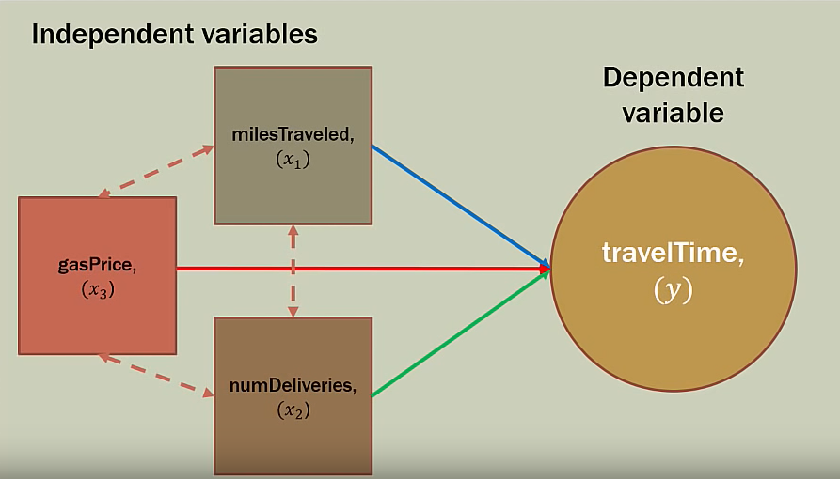
Step
Data preparation
Method:
Scatterplot
Correlation Analysis
Output
Include all the related IV
Eliminate & Choose one if Multicollinearity exist

Slide 6
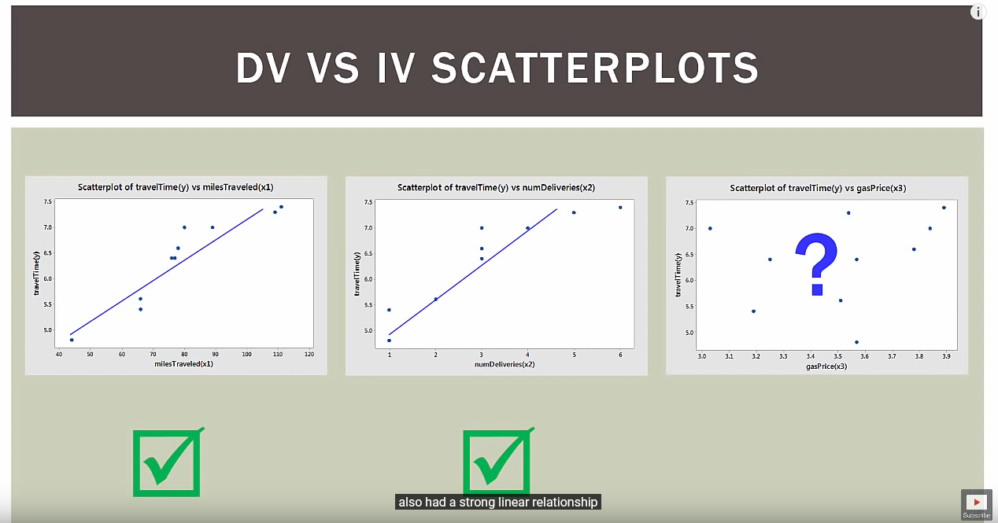
Step
Scatterplot
DV vs IV
Time x Miles (Related)
Time x Deliveries (Related)
Time x Gas (Not related)

Slide 7
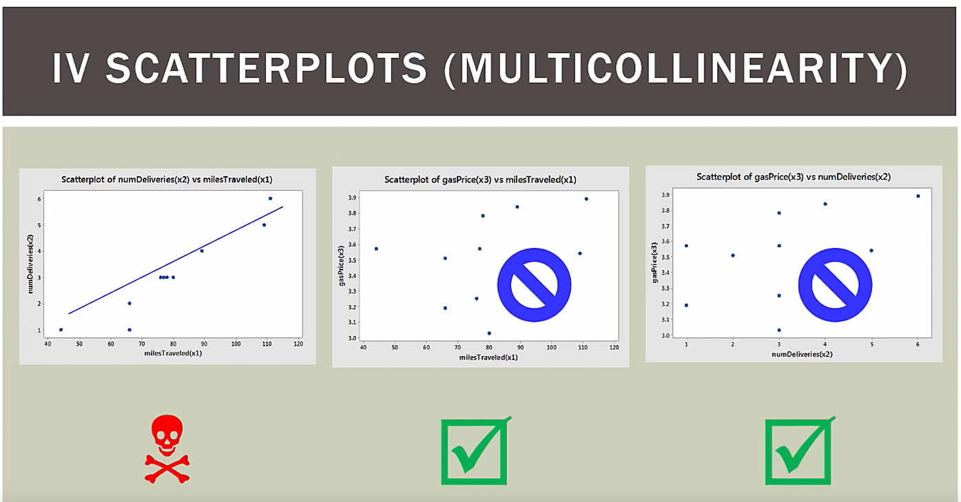
Step
Scatterplot
DV vs IV
Time x Miles (Related)
Time x Deliveries (Related)
Time x Gas (Not related)
IV x IV
Miles x Deliveries (Related)
Gas x Miles (Not related)
Gas x Deliveries (Not related)

Slide 8
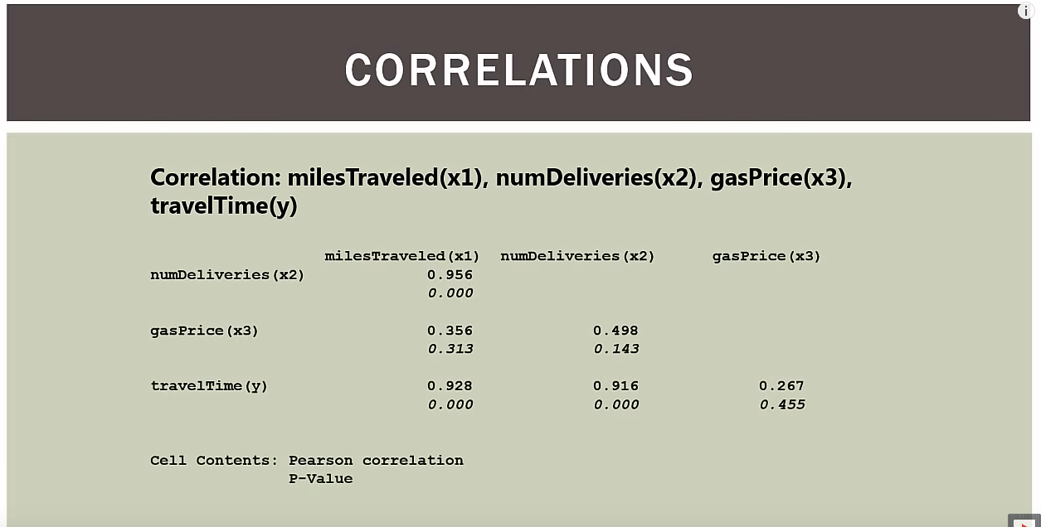
Step
b. Correlation Analysis
Compute the relation using correlation theory
Each resulting 2 values: Correlation Value (Top) & P Values (Bottom)
P Values = Significance Values for change (Higher than 0.05 is Insignificance)
Reference: https://www.youtube.com/watch?v=4EXNedimDMs
Result:
Deliveries x Miles = High Correlation + Significance (Multicollinearity)
Gas x Miles = Low Correlation + Insignificance
Gas x Deliveries = Low Correlation + Insignificance
Time x Miles = High Correlation + Significance
Time x Deliveries = High Correlation + Significance
Time x Gas = Low Correlation + Insignificance

Slide 9
Step
Data preparation
Method:
Scatterplot
Correlation Analysis
Output
Include all the related IV
Eliminate & Choose one if Multicollinearity exist

Slide 10
Step
Data preparation
Conclusion:
We should only use Miles + Deliveries for IV
Gas is not related to Time
Miles - Deliveries is Multicollinearity therefore only one shall be choose for IV

Slide 11
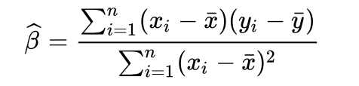
Step
2. Find gradient constants for each linear
For each linear we can calculate each gradient using:
// * Haven’t add any example or code, hopefully soon to be added
// - Andrea

Slide 12

Step
3. Create Equation
Y = The multilinear y value
βi = The gradient for each linear
Xi = The x value for each linear
// * Haven’t add any example or code, hopefully soon to be added
// - Andrea

Slide 13
Closing
The equation is easy to calculate
While preparing the linear which to depends, it need to be analyzed
We should consider the risk of Multicollinearity & Overfitting
This solution intended for more than 1 Independent Variable but for 1 Dependent Variable
It’s not the same as Multivariate Linear Regression
Thank you

